Slide 1

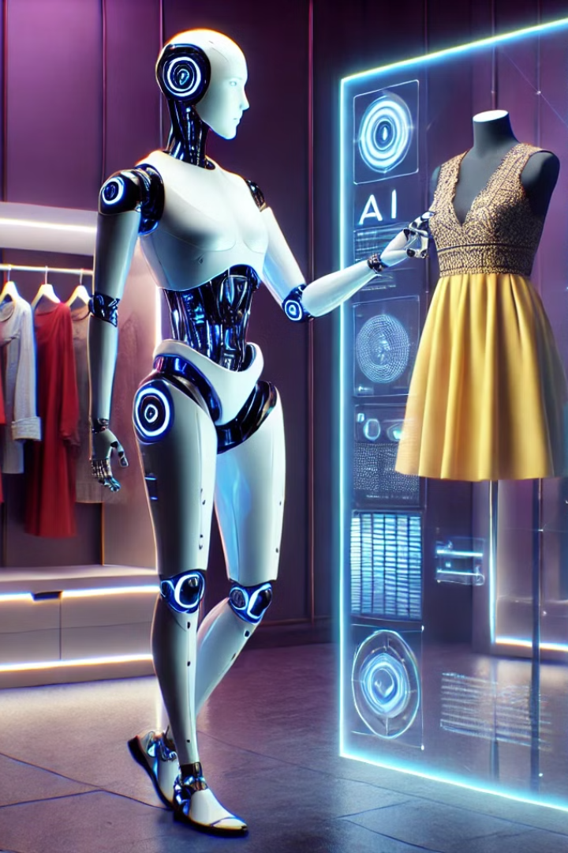
Infosys Springboard
AI Stylist: Personalizing Fashion Choices
Team:
1.Mohammad
2.Dheeraj
3.Shameera
4.Akshay
5.Lebin
Mentor :
Anil Shaw Sir

Slide 2

AI Stylist: Project Overview
1
Introduction
2
Project Goals
Understanding the AI Stylist project
What we aimed to achieve
3
System Architecture
4
Dataset Details
How the AI Stylist works
The data that powers the system
5
Collaborative Filtering
6
Content-Based Filtering
Recommendations based on user preferences
Recommendations based on visual features
7
Comparing Approaches
8
Pre-trained Models
Content vs. collaborative filtering
VGG16, DenseNet, MobileNet

Slide 3
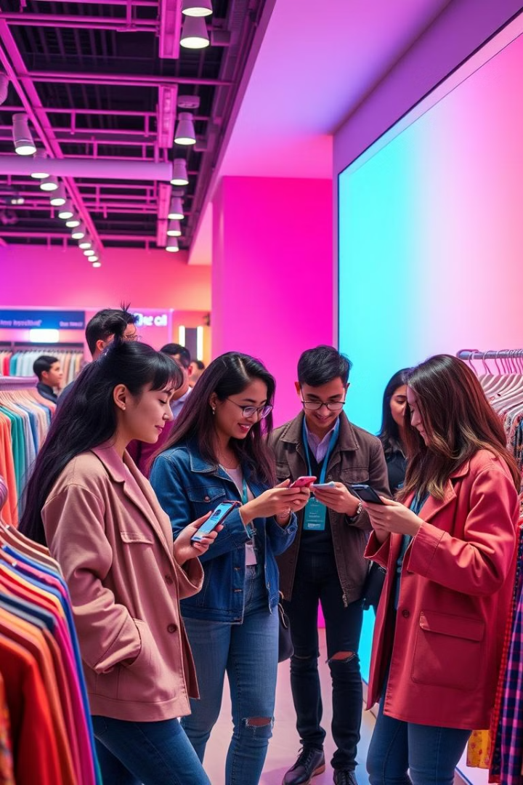
Empowering Personalized Style
Goal: create an AI-powered personal stylist that helps users discover new styles, find clothing they love, and express themselves confidently.
Develop an AI-based system to recommend clothing items.
Enhance user experience with personalized and visually appealing suggestions.
Leverage data and AI to match user preferences with suitable products.

Slide 4
AI Stylist: System Architecture
User Interaction
Image Processing
Recommendation Engine
User Feedback
Input: User preferences, style goals, and visual queries
Analyzing clothing images, extracting visual features
Learning from user interactions and improving recommendations
Content-based and collaborative filtering algorithms

Slide 5

Dataset: Fashion Insights
Dataset: millions of clothing images, tagged with attributes
such as brand, style, color, size, and price.
Purpose: Provides data to recommend clothing items.
Features:
Product Details: Name, category, price, and brand.
User Behavior: Ratings, reviews, and purchase history.
Visuals: Images of clothing items.

Slide 6
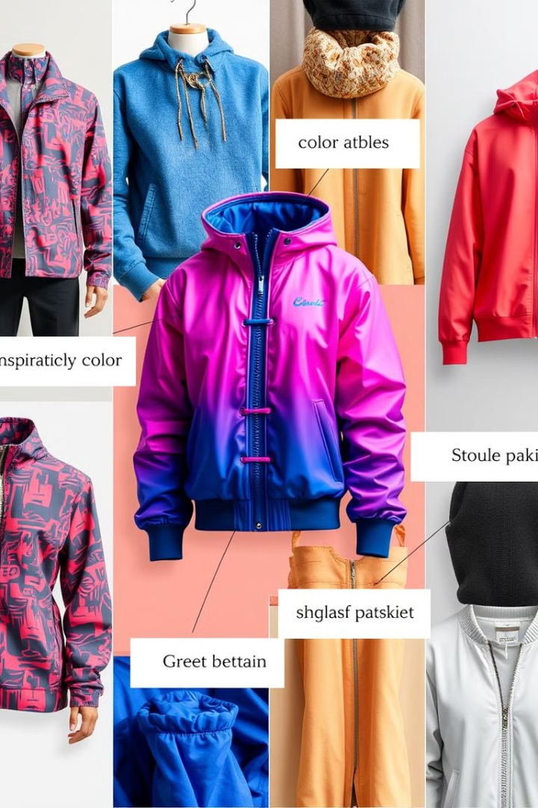

Content-Based Filtering
Definition: Recommends items similar to what the user has liked or interacted with before.
How It Works: Uses item features (e.g., style, color, material) to compute similarity between products.
Tools/Techniques: TF-IDF, cosine similarity, embeddings.
Example: If a user likes red dresses, similar red dresses are recommended.

Slide 7

Collaborative Filtering
Recommends items based on user behavior or preferences.
User-based: Suggests items liked by similar users.
Item-based: Recommends items frequently liked together.
Example: Suggests shoes to a user who bought jeans.

Slide 8
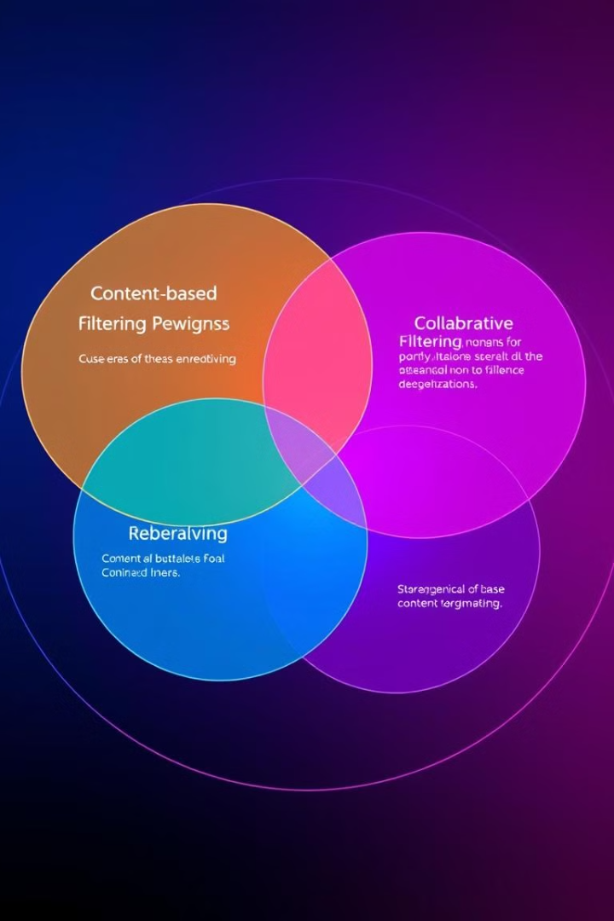
Content vs. Collaborative Filtering
Content-based filtering focuses on visual similarity, while collaborative filtering considers user preferences and interactions.
Content-Based Filtering:
Recommends items based on their features (e.g., style, color, material). Suggests similar items to those a user has liked before.
Collaborative Filtering:
Recommends items based on user behavior and preferences. Suggests items liked by other users with similar tastes.

Slide 9
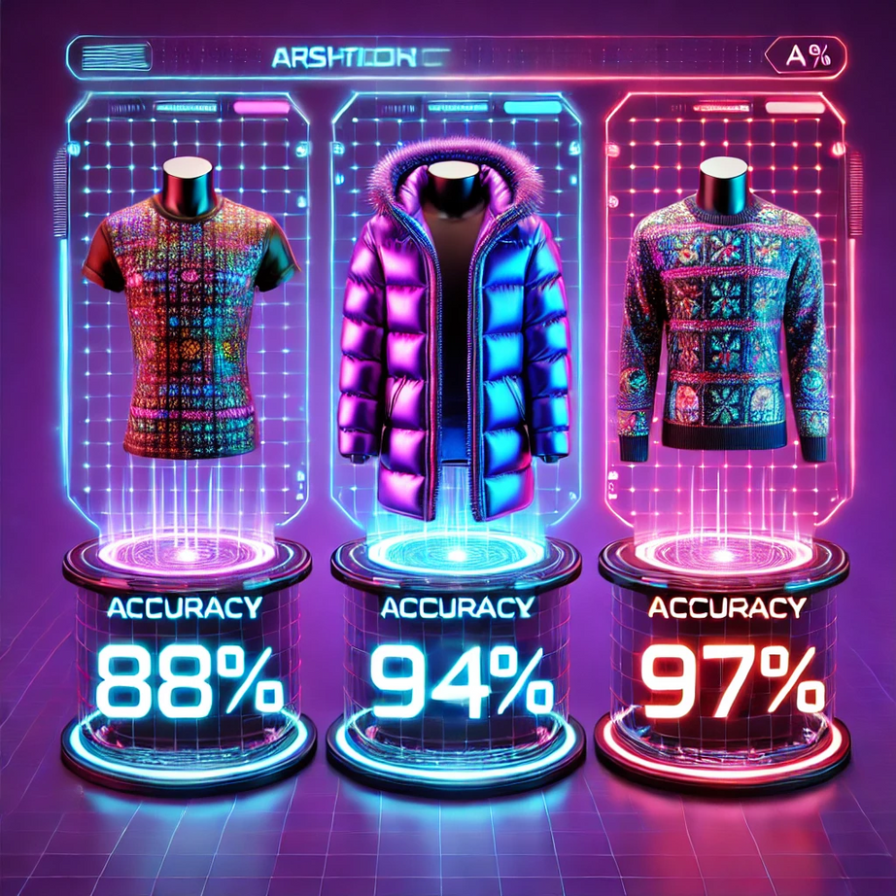
Leveraging Pre-trained Models
MobileNet
Fine-tuned to extract visual features from clothing images.
DenseNet
Fine-tuned to extract visual features from clothing images.
VGG16
Fine-tuned to extract visual features from clothing images.

Slide 10
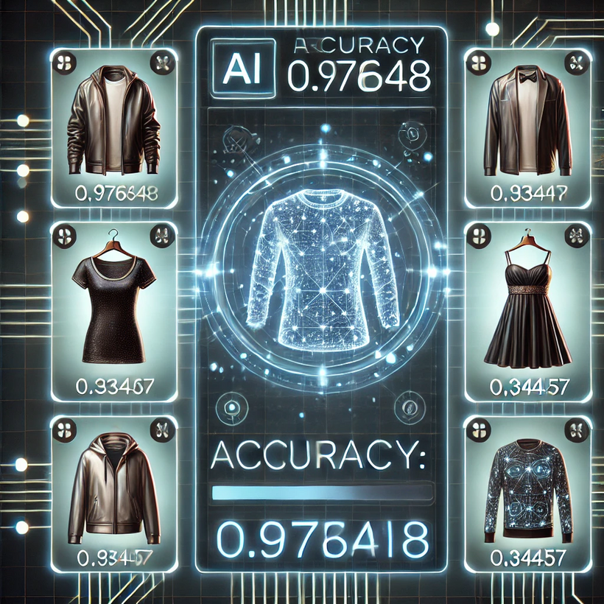
Precision in Every Choice
Our AI-powered recommendation system leverages state-of-the-art machine learning models to provide highly personalized and accurate recommendations.
The models were trained on a rich dataset, and their performance was rigorously evaluated using metrics like accuracy, precision, recall, and F1-score. Through iterative optimization and cross-validation techniques, the system achieved an impressive accuracy rate, ensuring reliable and meaningful recommendations for users.

Slide 11

Thank You!
Thank you, Infosys-springboard, and my mentor Mr. Anil Shaw for your guidance and support. Grateful to my team for their collaboration and dedication throughout this journey..

